Slide 1
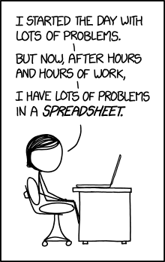
Lab 6 -
Container ADTs

Slide 2
ReadMe
Reminders
Lab 6 due Sunday, October 28th at 8pm
Project 3 due TONIGHT at 8pm
Review session - Sunday October 28th, 4pm in CHRYS 220
Exam - Wednesday October 31st (Halloween!) at 7pm
Agenda
15
Container ADTs + Worksheet
Employee statistics
Exam practice
Lab time & questions
5
40
50

Slide 3
Review: ADTs
ADTs are Abstract Data Types.
ADTs bind functions & data into a type/class that exposes an interface.
ADTs allow us to abstract the world around us
Useful properties to remember:
Abstraction, Encapsulation, Information Hiding.

Slide 4
Containers
Containers are a special type of ADT often used in computer science
A Container is an ADT that stores other ADTs.
Gives us a way to reason about multiples of ADTs.
Computer Scientists like working with things at scale: Think about our Fruit ADT. How do you write a program to deal with millions or billions of Fruits (watermelons, apples, oranges, pears, grapes, etc.)?
Can you think of some important features you’d want a container to have?

Slide 5
Containers
You will often see containers support the following operations:
Add an element
Remove an element
Check size of the container/ see if it’s empty
“Special” features:
Access a particular element, search, sort, remove particular element
What are these operations for a vector?

Slide 6
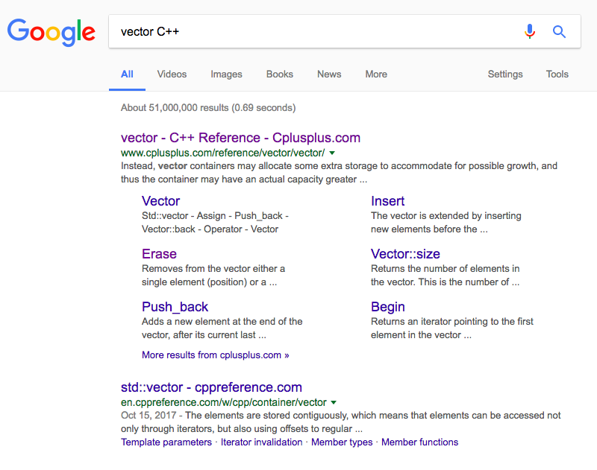
Let’s look it up!

Slide 7

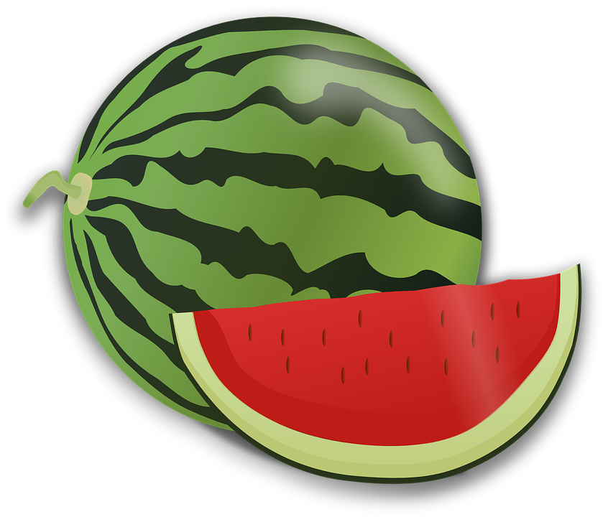

Polymorphism and Containers
class Fruit {
…
}
class Banana : public Fruit {
…
}
class Watermelon : public Fruit {
…
}
class Apple: public Fruit {
…
}
Banana banana1();
Banana banana2();
Watermelon watermelon1();
Apple apple1();
Fruit* groceries[4] = {&banana1, &banana2, &watermelon1, &apple1};
for(int i = 0; i < 4; ++i) {
groceries[i]->eat();
//we automatically call the right “eat” function!
}

Slide 8
Worksheet!

Slide 9
Remember the Employee ADTs?
We have some statistics about the employees we made!
We take these statistics every term to open a dialogue about DEI in EECS
What causes results like this? What can we do about it?
TED talk by Yassmin Abdel-Magied
Her main point: everyone has unconscious biases. She proposes that we could improve this situation by mentoring someone different from ourselves.
Speaking of this…
How to be an EECS IA Panel!
Co-hosted by GEECS & Computing Cares
October 29th from 7:30pm - 8:30pm in BBB 1690

Slide 10
Midterm Topics to Review:
Lectures 1-10 are covered
Procedural Abstraction & Call Stack
Pointers and Arrays
String Streams & IO
Compound Objects
C style ADTs
C++ style ADTs
Inheritance
Polymorphism
My personal advice:
*Go through all of the lecture slides/ redo examples
*Make your cheat sheet as you go
*Redo lab activities & glance at projects

